Slide 1

Data analyst vs Data Engineer Roadmap and more
Hessam Mohammad Hosseini
مدرسه پردازش و تحلیل دقیقه
حسام محمدحسینی

Slide 2
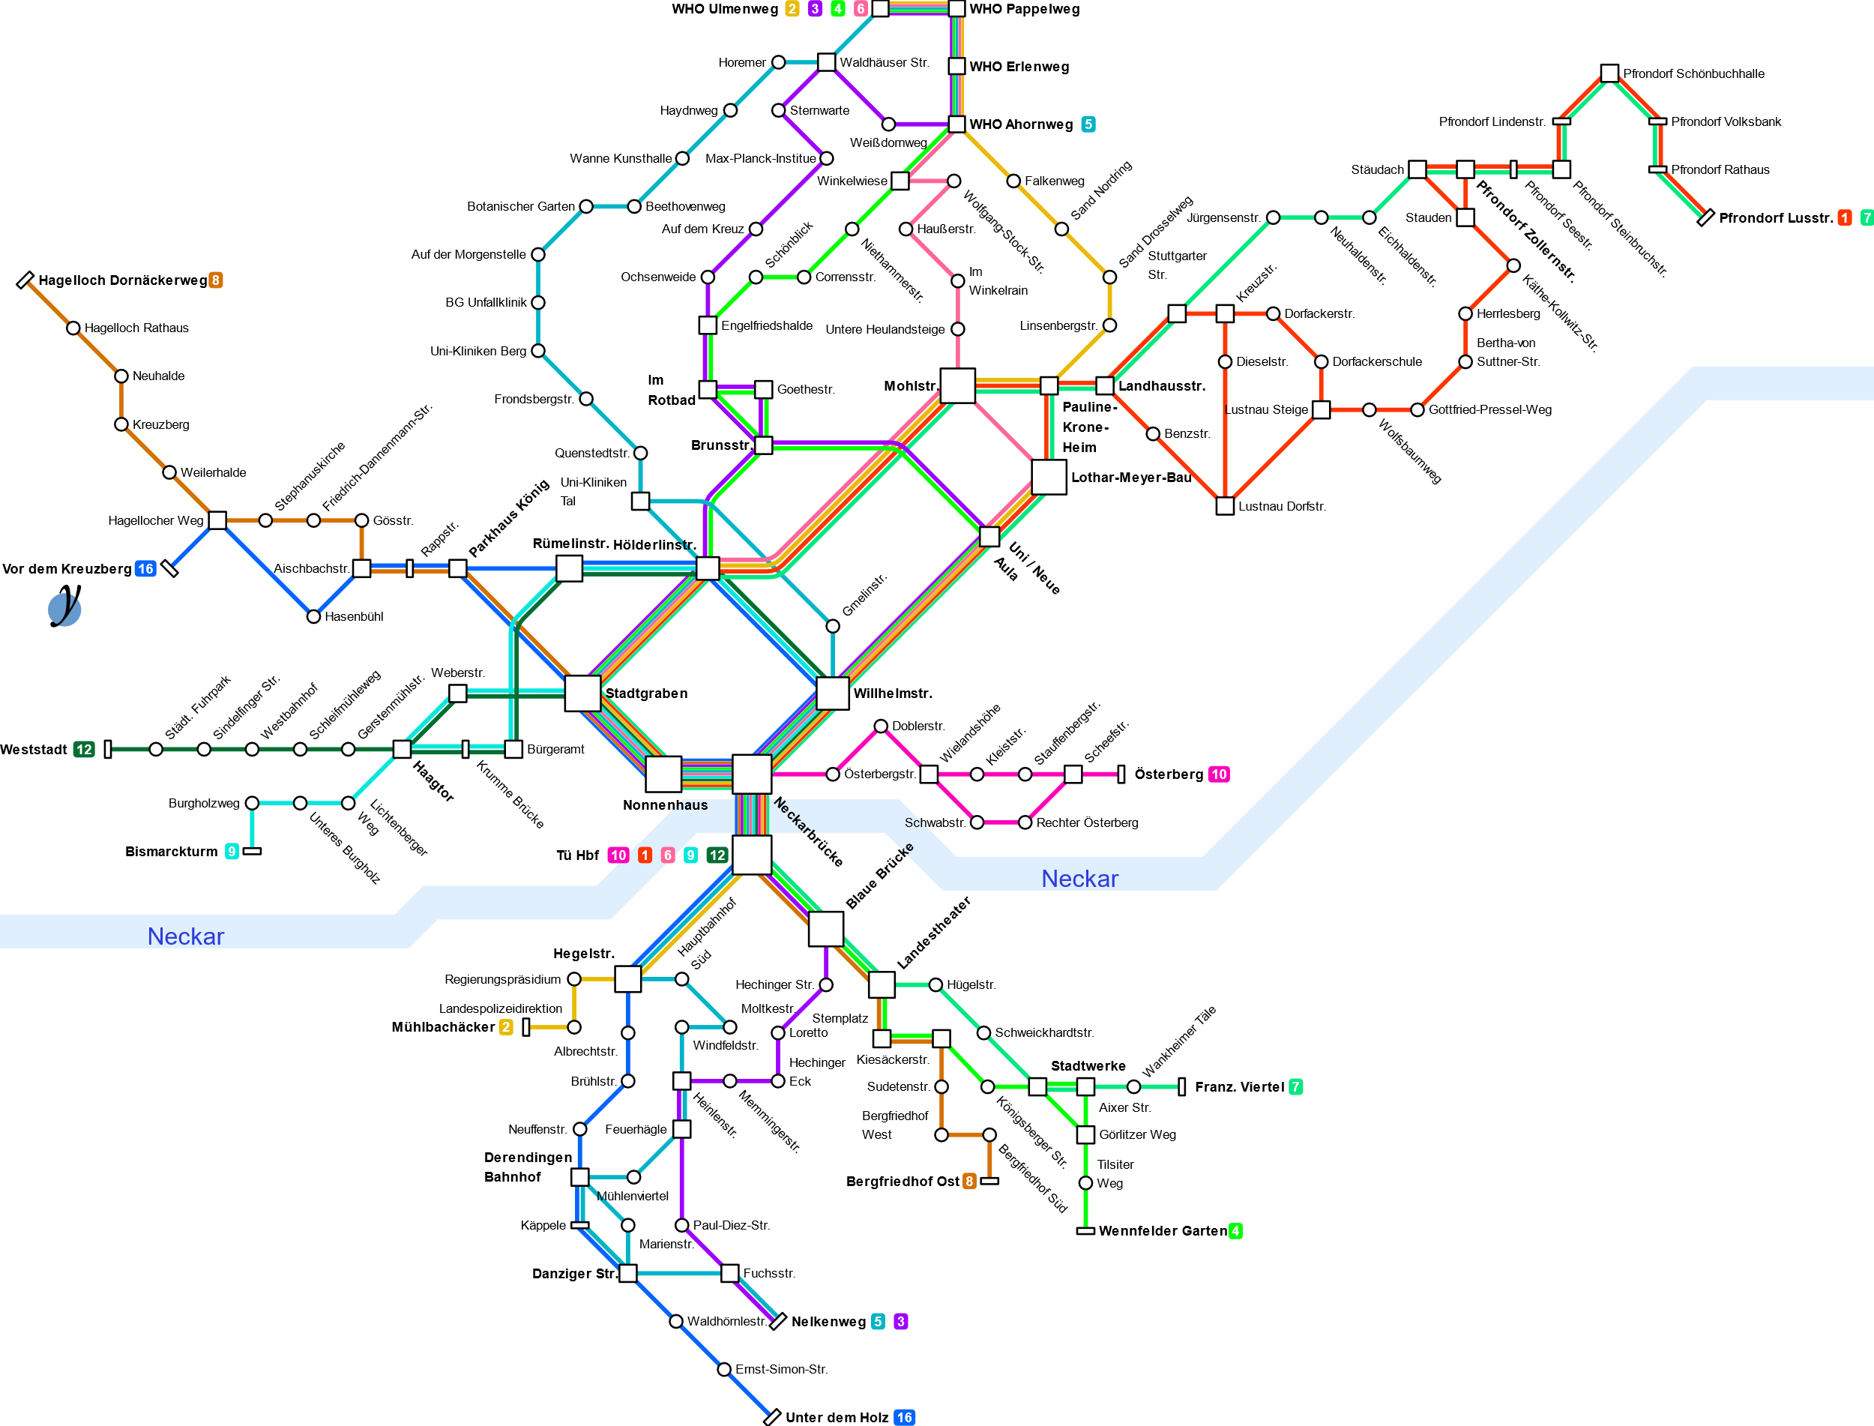

Slide 3
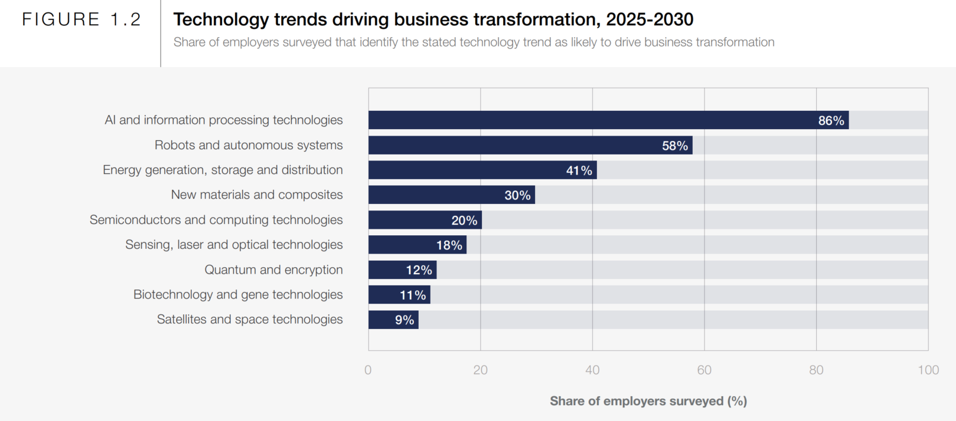
Data Skills on denmand

Slide 4
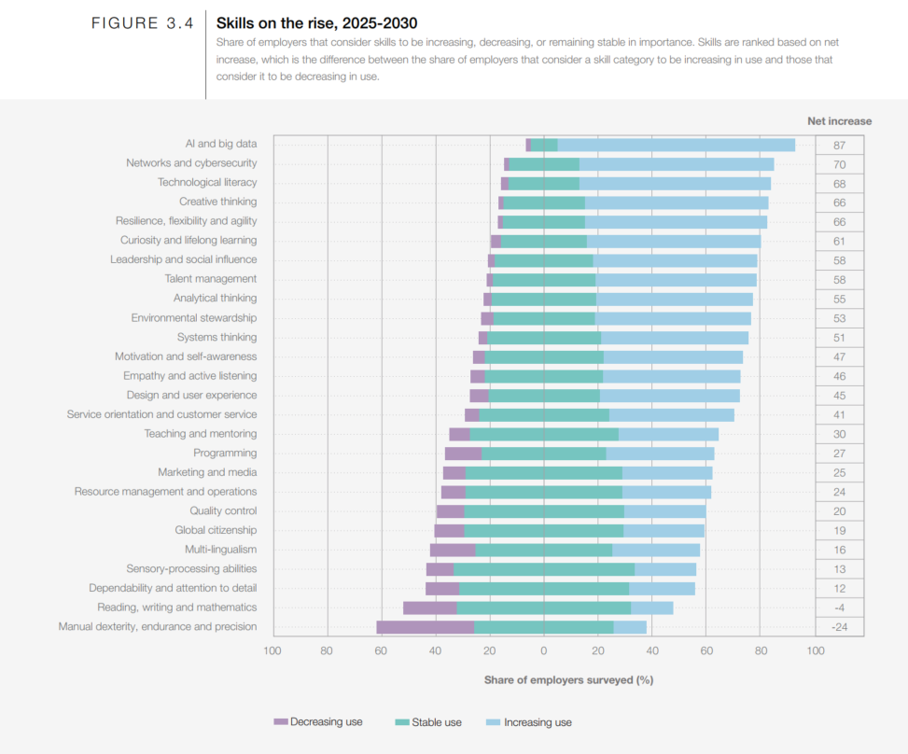

Slide 5
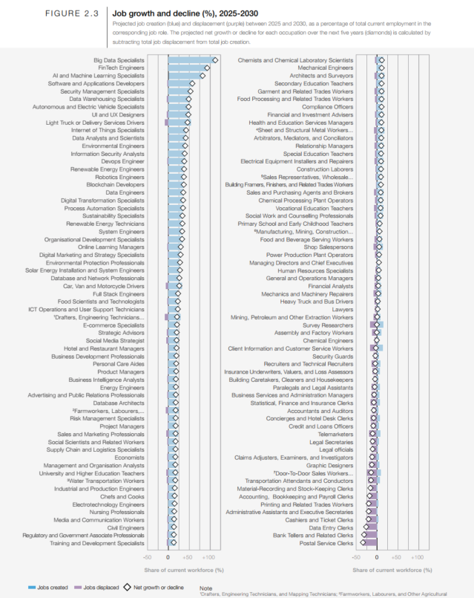

Slide 7
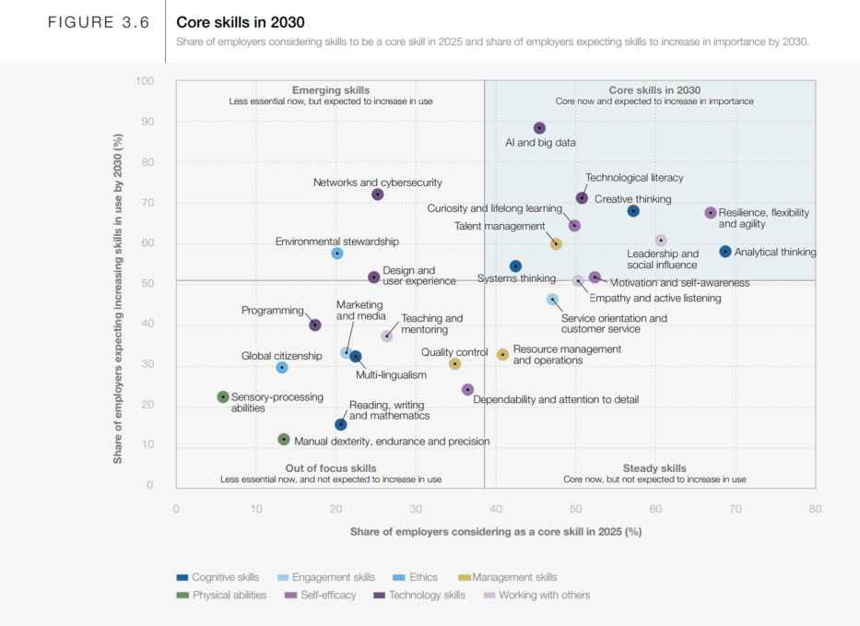

Slide 8

DS needs
https://microsoft.github.io/azureml-ops-accelerator/1-MLOpsFoundation/2-SkillsRolesAndResponsibilities/1-AdoptingDSProcess.html

Slide 9
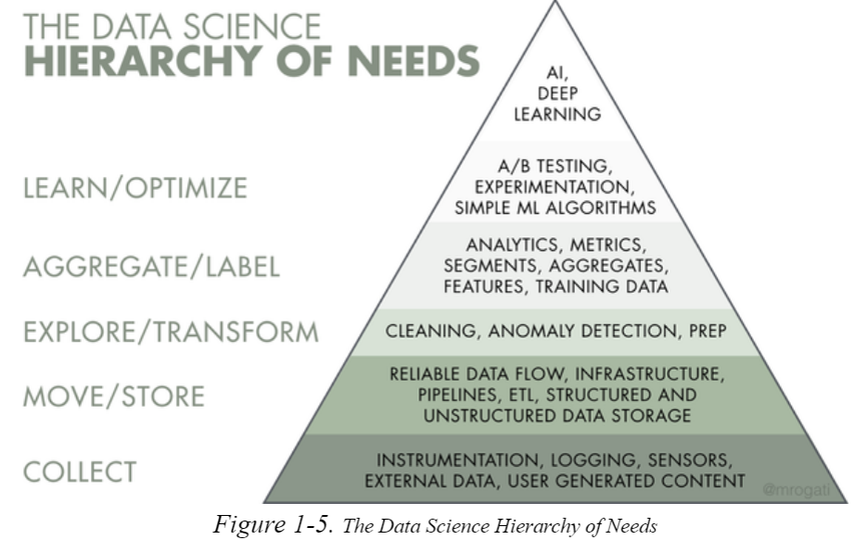
Data Science needs

Slide 10
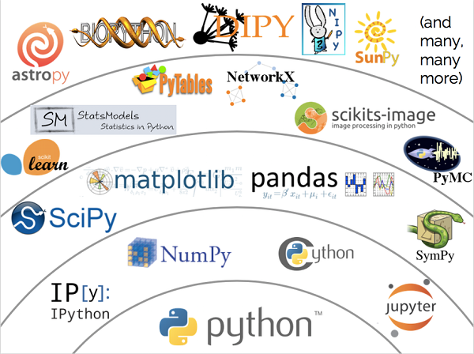
Tech stack

Slide 11
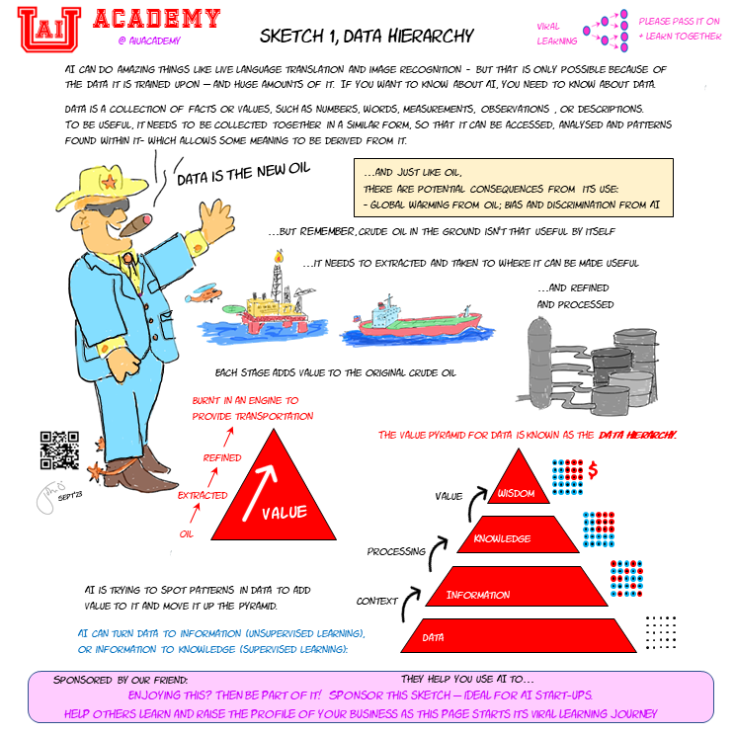

Slide 12
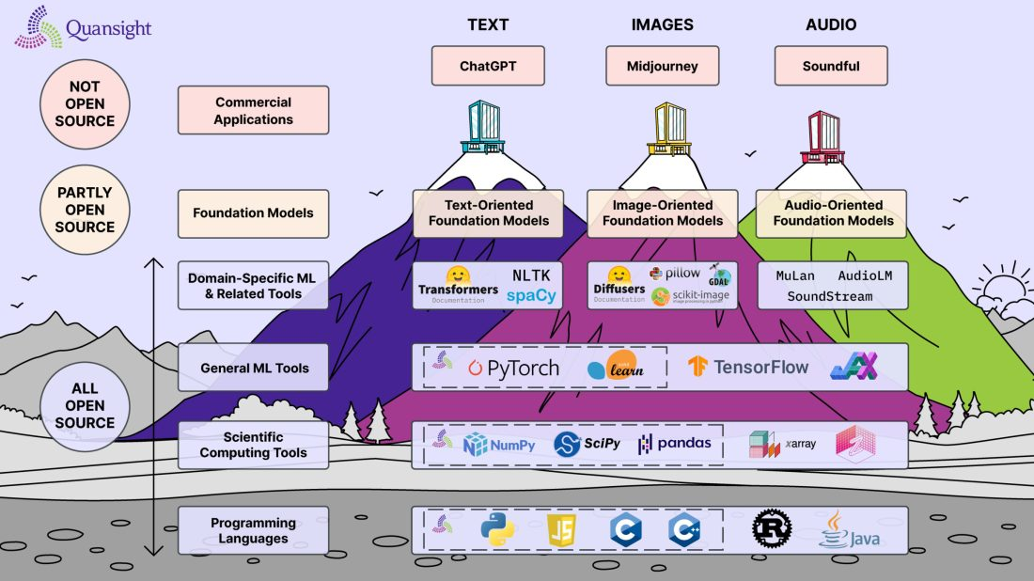
“If I have seen further, it is by standing on the shoulders of giants.”

Slide 13
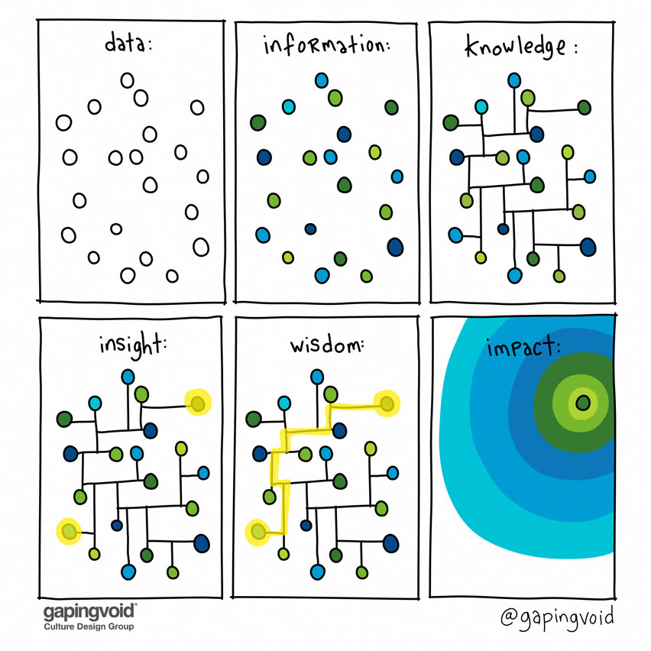
DS needs

Slide 14
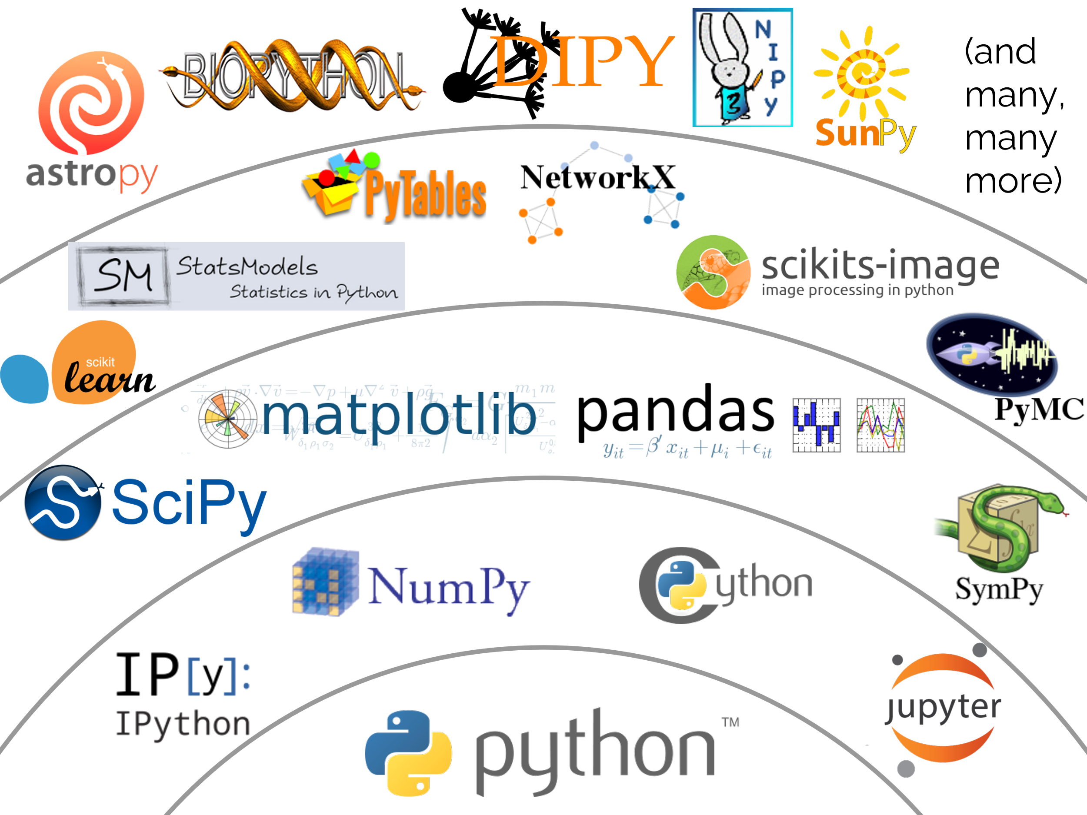
Connecting

Slide 15
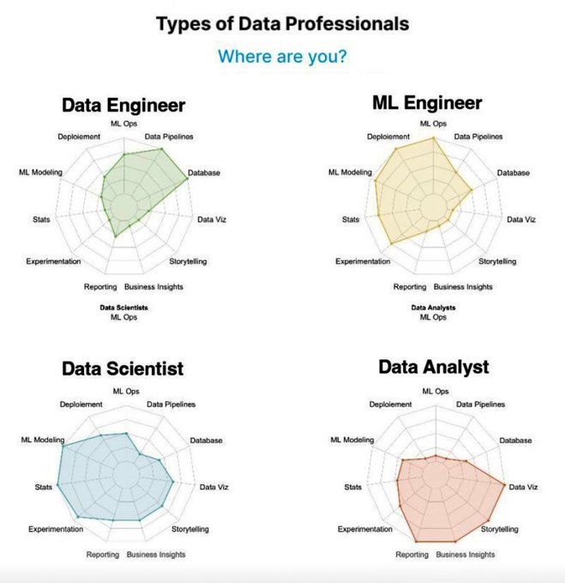

Slide 16
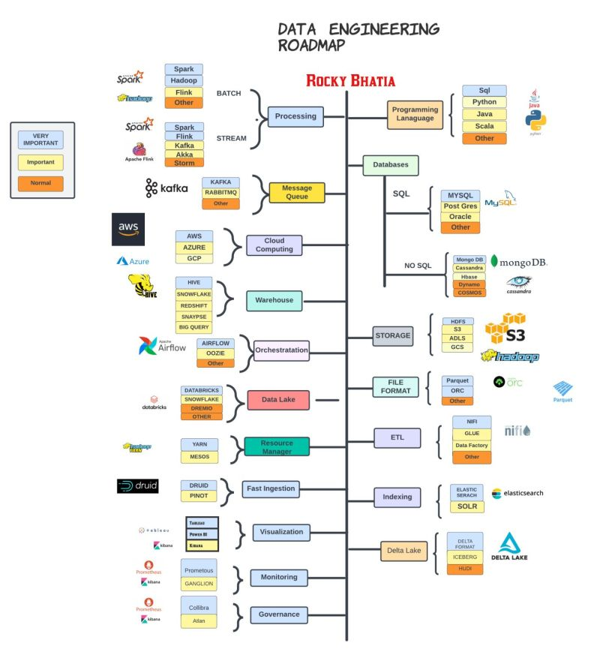
Data Eng. Roadmap

Slide 17
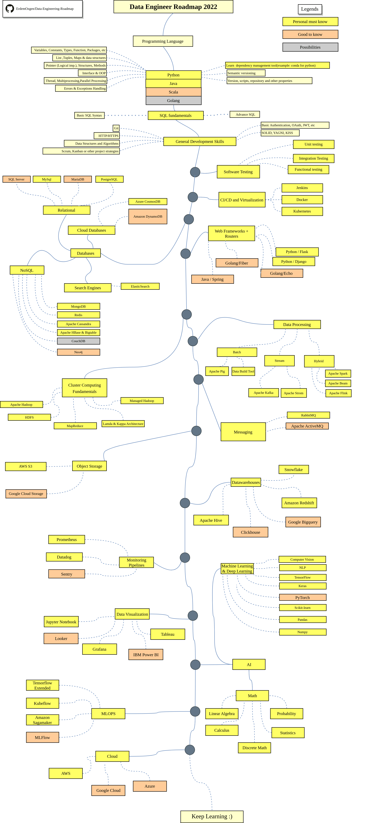
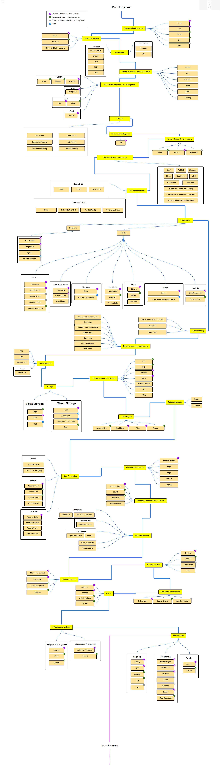

Slide 18
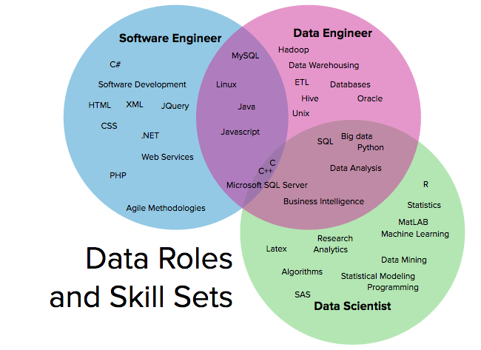

Slide 19
DS needs
Domain Knowledge
Data preprocessing (cleaning)
Data analysis
Data Analytics
Missing data handeling
LLMs (Chatbots) could help

Slide 20
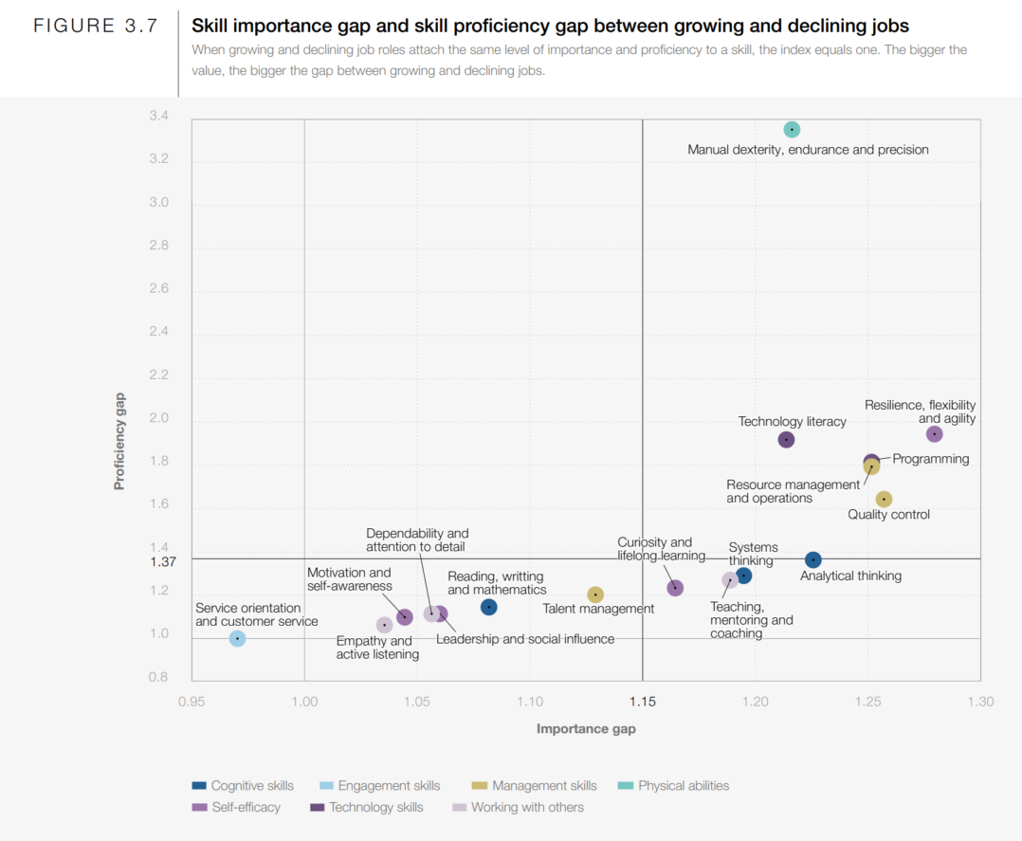

Slide 21
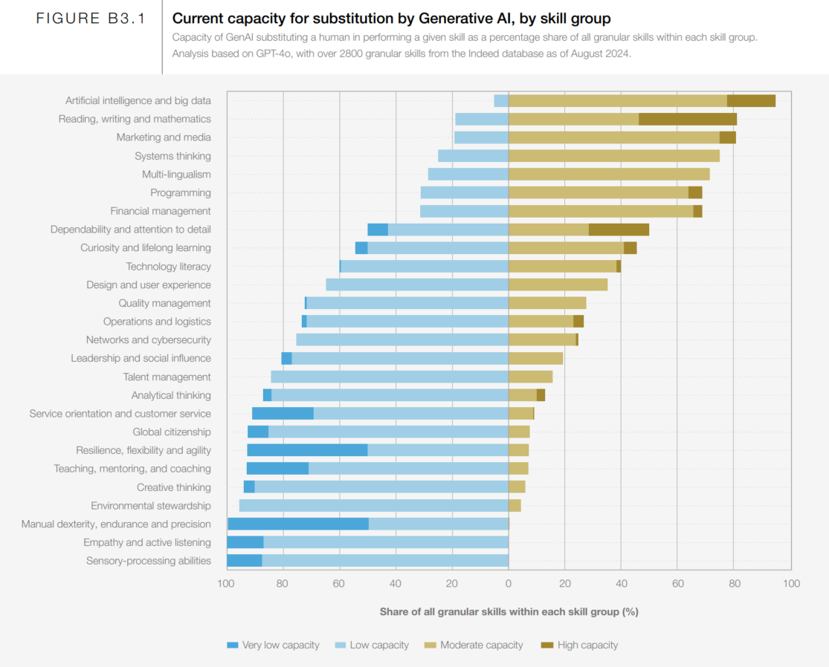

Slide 22
Skill set
Data Analyst | Data Engineer | Data Scientist
Data Warehousing | Data Warehousing & ETL | Statistical & Analytical skills
Adobe & Google Analytics | Advanced programming knowledge | Data Mining
Programming knowledge | Hadoop-based Analytics | Machine Learning & Deep learning principles
Scripting & Statistical skills | In-depth knowledge of SQL/ database | In-depth programming knowledge (SAS/R/ Python coding)
Reporting & data visualization | Data architecture & pipelining | Hadoop-based analytics
SQL/ database knowledge | Machine learning concept knowledge | Data optimization
Spread-Sheet knowledge | Scripting, reporting & data visualization | Decision making and soft skills

Slide 23
Roles and Responsibilities
Data Analyst | Data Engineer | Data Scientist
Pre-processing and data gathering | Develop, test & maintain architectures | Responsible for developing Operational Models
Emphasis on representing data via reporting and visualization | Understand programming and its complexity | Carry out data analytics and optimization using machine learning & deep learning
Responsible for statistical analysis & data interpretation | Deploy ML & statistical models | Involved in strategic planning for data analytics
Ensures data acquisition & maintenance | Building pipelines for various ETL operations | Integrate data & perform ad-hoc analysis
Optimize Statistical Efficiency & Quality | Ensures data accuracy and flexibility | Fill in the gap between the stakeholders and customer

Slide 24
سوال و جواب

Slide 25
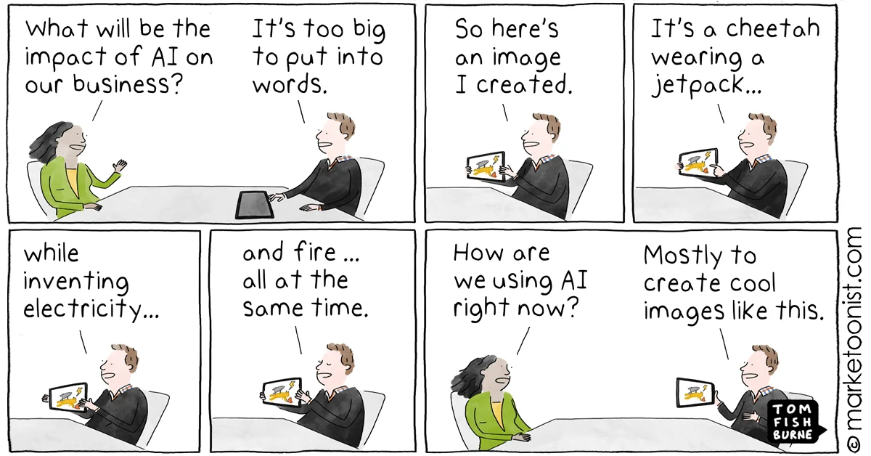
Al effect

Slide 26


